Slide 1
The Client Facilitator
Tax Year 2015
Notes:
The Client Facilitator is generally the first “face” the client sees when coming to a site.
They “facilitate” the start of the process of determining if the client is eligible to use AARP’ Tax-Aide’s services and ensuring the client has all the needed documents.

Slide 2
What/Who is a Client Facilitator?
The Client Facilitator (CF) greets taxpayer, facilitates orderly service, conducts initial screening and interview, and assists in collection and record of site service counts.
Notes:
Site-specific, but potential tasks can include:
Greets the client;
Maintains the sign-in log;
Explains the tax prep process and possible wait time;
Explains ID documents required;
Explains tax documents required;
Explains completion of the Form 13614C – intake questionnaire;
Screens the intake questionnaire to ensure it is complete;
Directs clients to other sites such as state or local, Social Security, etc.
Starts the envelope for holding taxpayer documents

Slide 3
What/Who is a Client Facilitator?
Greeter, Screener, Interviewer
Does not answer tax questions or give tax advice, unless a certified Counselor
Local Coordinator or a Counselor can also be a Client Facilitator
Notes:
Site-specific, but potential tasks can include:
Greets the client;
Maintains the sign-in log;
Explains the tax prep process and possible wait time;
Explains ID documents required;
Explains tax documents required;
Explains completion of the Form 13614C – intake questionnaire;
Screens the intake questionnaire to ensure it is complete;
Directs clients to other sites such as state or local, Social Security, etc.
Starts the envelope for holding taxpayer documents

Slide 4
Benefits of a Client Facilitator
Creates pleasant welcoming atmosphere at site
Calms worried and impatient taxpayers
Avoids unnecessary taxpayer delays
Brings order to administration tasks
Increases site productivity
Notes:
Wear nametags—first name and last name initial (not full last name)
Know your hours and be on time to greet taxpayers
Get to know your site coordinator and preparers
Stressed out/confused taxpayers need a positive, non-confrontational attitude
If clients get pushy or intimidating, get the site coordinator to handle
When in doubt or have questions, go to the Site Coordinator.
Direct taxpayers to posters if necessary, but never turn a client away without site coordinator getting involved.

Slide 5
Client Facilitator Qualifications
Personable, organized, patient, diligent
Knows Tax-Aide policies and site procedures
Need not be certified Counselor
Notes:
Client facilitators:
Responsibilities are site specific
But can be broad and demanding
Can play a vital role
Are often under-utilized and under-appreciated

Slide 6
Requirements to be Client Facilitator
Complete AARP Volunteer Site Policy and Procedure training
Pass Volunteer Standards of Conduct (VSC) test
Sign Volunteer Agreement – Form 13615
Notes:
Client facilitators:
Responsibilities are site specific
But can be broad and demanding
Can play a vital role
Are often under-utilized and under-appreciated

Slide 7
Client Facilitator Tasks
Greets and welcomes taxpayer
Ensures taxpayer is logged in on activity log
Alerts Local Coordinator or Shift Coordinator if taxpayer requires/ requests special assistance
Explains Interview/Intake Sheet – assists with completing as necessary
Assigns taxpayer to Counselor following site procedures
Ensures activity log updated when taxpayer departs site
Additional duties as assigned by LC
Notes:
“Potential” tasks – depends on how well the CF is trained and used and if the LC specifies other duties.
BEST PRACTICE: have the CF highlight the boxes on income documents of the taxable amounts and any withholding amounts, if they feel comfortable or knowledgeable enough to do this.
BEST PRACTICE: Have the client facilitator review the intake sheet and highlight any positive “YES” or “UNSURE” answers. This will help to make the counselor aware when they are reviewing the intake.

Slide 8
Tasks – If Applicable to Site
Ensures every applicable question on Intake Sheet is answered “YES” or “NO” or “UNSURE”
Makes sure taxpayer has SSN or ITIN for everyone on return and verifies ID
Sorts documents in Form 1040 order by taxpayer/spouse
Check documents – are they “in scope”?

Slide 9
Client Facilitator Job Aids
Form 13614-C
Site Sign In/Activity Sheet
In Scope/Out of Scope Poster
Local Social Security offices/addresses
Other local city or state office addresses that might be needed or helpful
List of frequently used acronyms
Notes:
Provide CF’s with the tools they will need to do their job.
Hand-Out – Glossary of Acronyms
Go through the Form 13614-C with new CF’s.

Slide 10
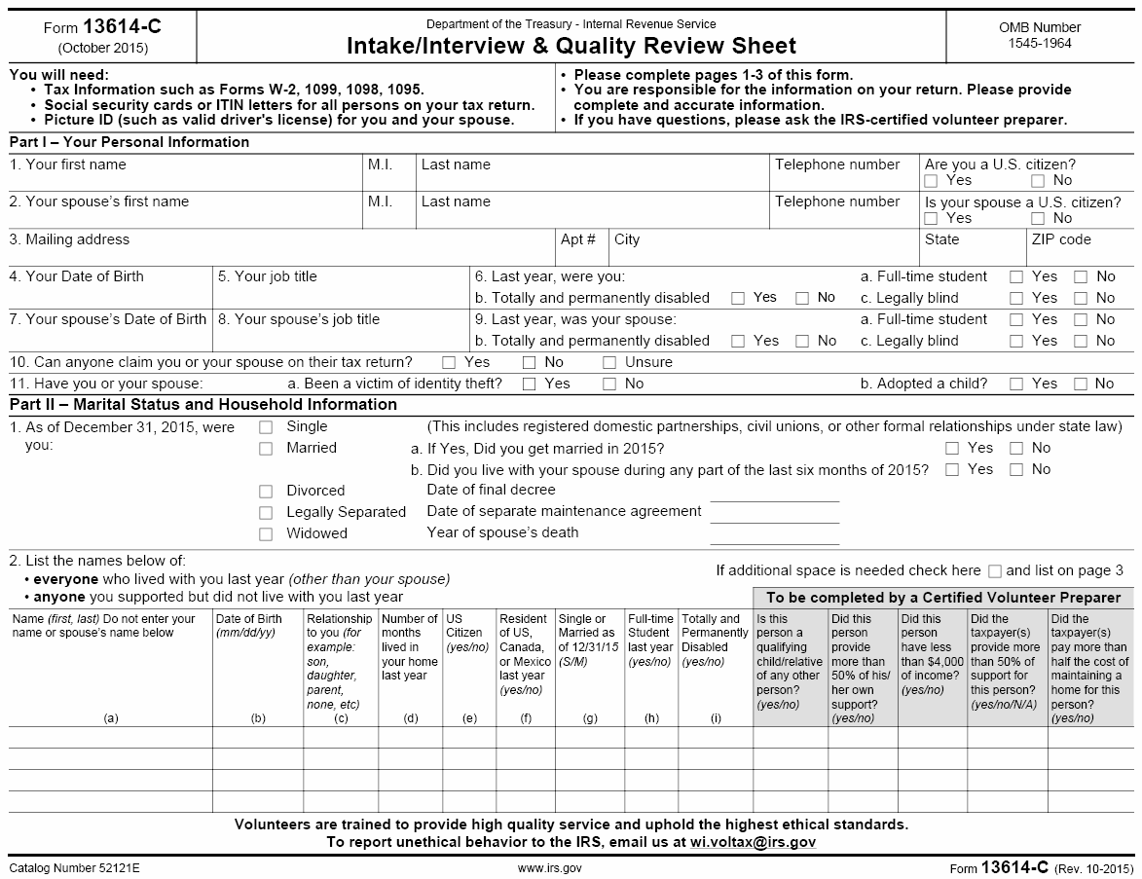
Notes:
Provide CF’s with the tools they will need to do their job.
Hand-Out – Glossary of Acronyms
Go through the Form 13614-C with new CF’s.

Slide 11
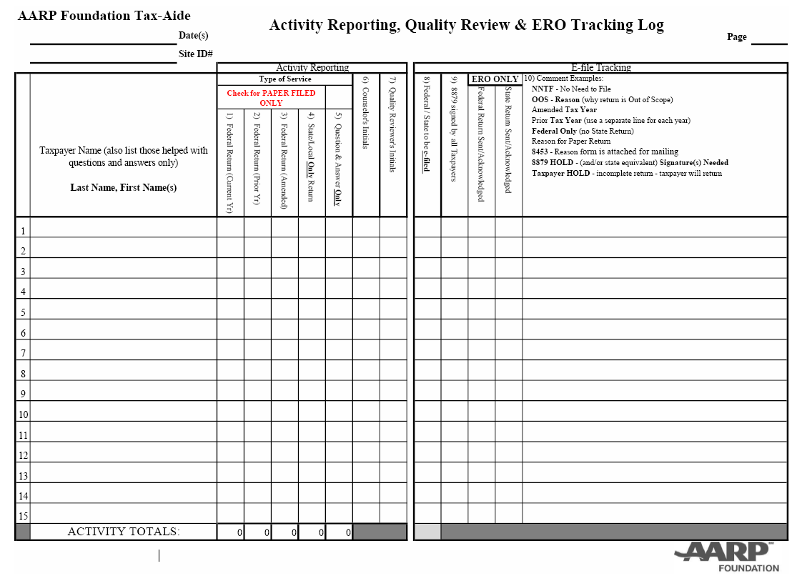
Notes:
Provide CF’s with the tools they will need to do their job.
Hand-Out – Glossary of Acronyms
Go through site sign in/activity sheet with new CF’s.

Slide 12
Typical Forms…
W-2 (Wage and Tax Statement)
W-2G (Certain Government Payments)
1065, Schedule K-1 (Partner’s Share of Income, Deductions, Credits, etc.)
1095-A (Health Insurance Marketplace Statement)
1099-R (Distribution from Pensions, Annuities, Retirement or Profit Sharing Plans, IRAs, Insurance Contracts, etc.)
1099-INT (Interest Income)
1099-DIV (Dividends & Distributions)
1099-MISC (Miscellaneous Income)
1099-G (Certain gambling winnings)
1099-B (Proceeds from Brokers and Barter Exchange Transactions)

Slide 13
Tax-Aide Process
Door
Missing documents or ID, out of scope, …
Taxpayer
Taxpayer
Forms printed and signed
Welcome and greet
Sign-in
Client Facilitator
Taxpayer fills out Intake Sheet
Taxpayer
Return(s) Quality Reviewed
Taxpayer
Screen
Taxpayer
Counselor prepares tax return(s)
Notes:
For the new CF – Provide an overview of the process a client goes through at a Tax-Aide site.

Slide 14
Client Facilitator
Questions?
Comments…
Notes:
CF’s are the AARP client’s first interviewer with Tax-Aide and play a vital role in setting the stage for a cooperative exchange and successful and accurate tax return preparation!

